Slide 1

Thesis work: AI/ML for battery modelling (electro-chemo-mechanical)
Notes:
Ändra gärna färg på bakgrunden till någon av de ljusa bakgrundsfärgerna.
Addera ett beskuret mönster för mer dynamiskt uttryck.

Slide 2
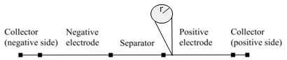
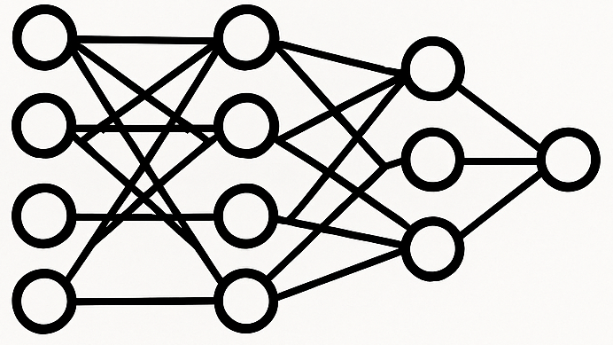
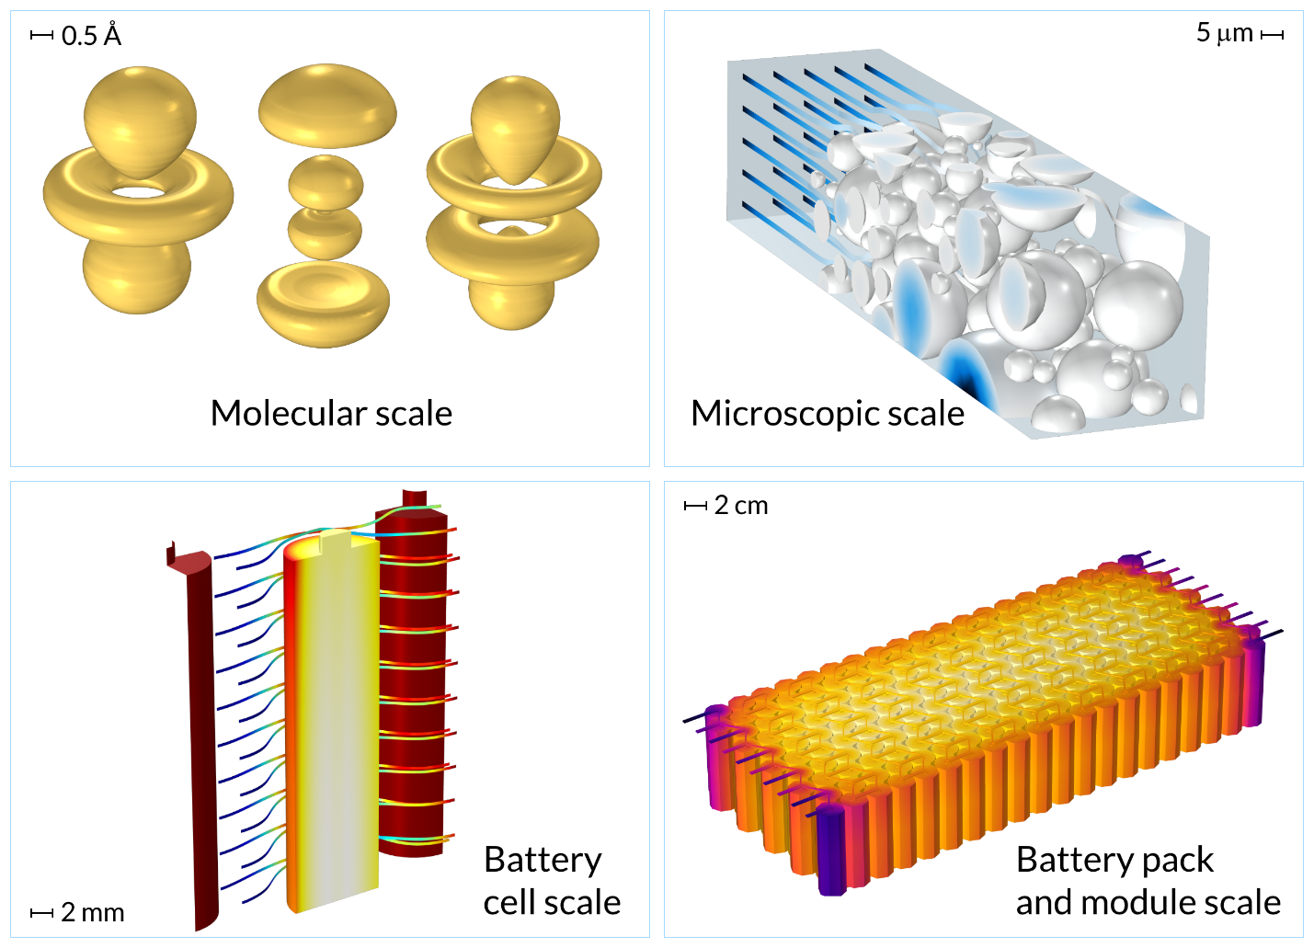
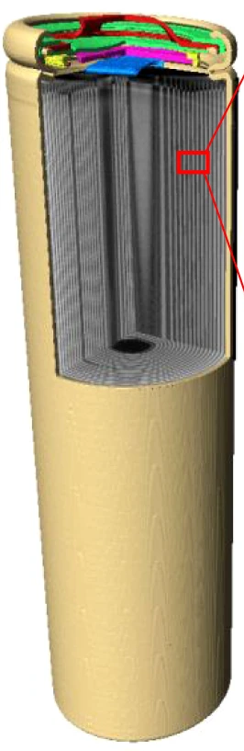
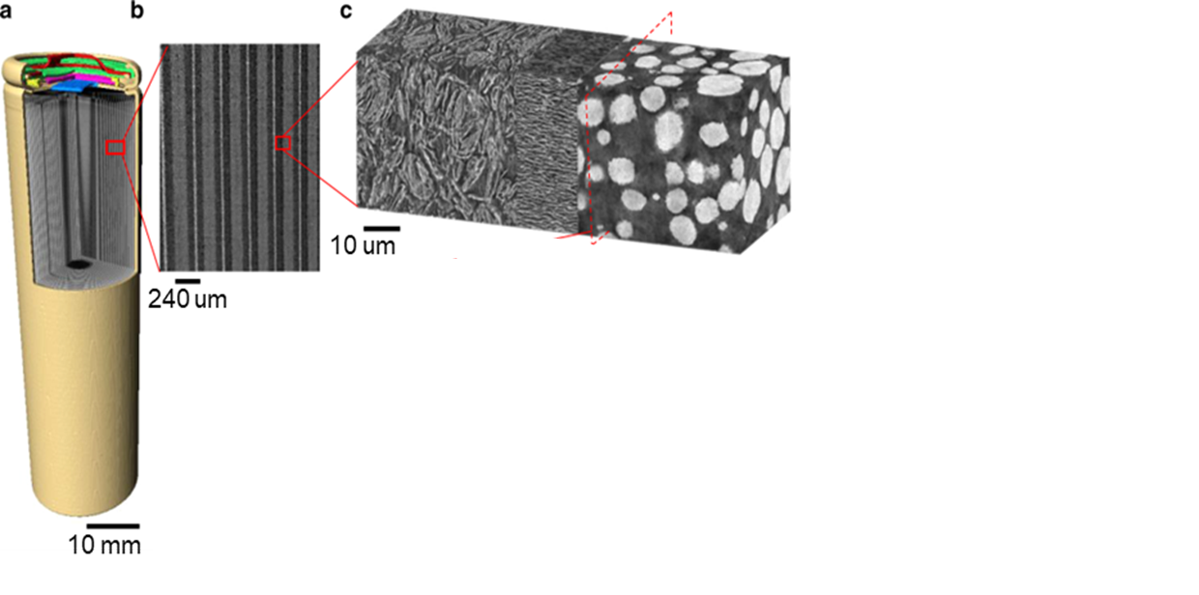
Project objective: Multiphysics battery model for lifetime prediction
Main focus
High fidelity microscale model (available)
Upscale response
1D
Features
Targets
Cell level response
3D
Physical constraints
Images/Photo from:
Fontes & Ekström, COMSOL archive
Lu et al., Nature Communication, 2020

Slide 3





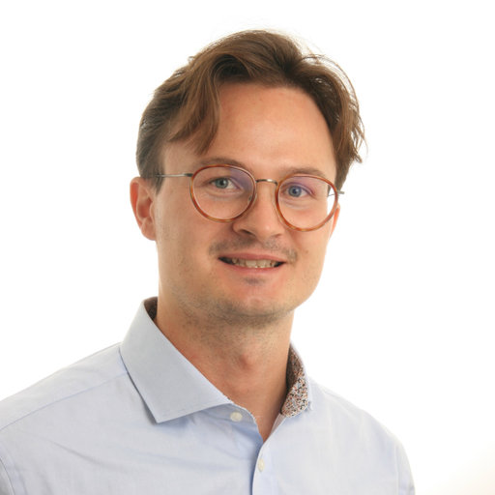


Thesis team
Students:
Supervisor team:
Jesper & Jonatan, M.Sc. Physics Chalmers, emphasis on computational methods, material physics and AI/ML
RISE: David Carlstedt & Michele Godio
(Dept. Chemistry & Applied Mechanics)
Chalmers: Knut-Andreas Meyer & Fredrik Larsson (Div. Material and Computational Mechanics)

Slide 4
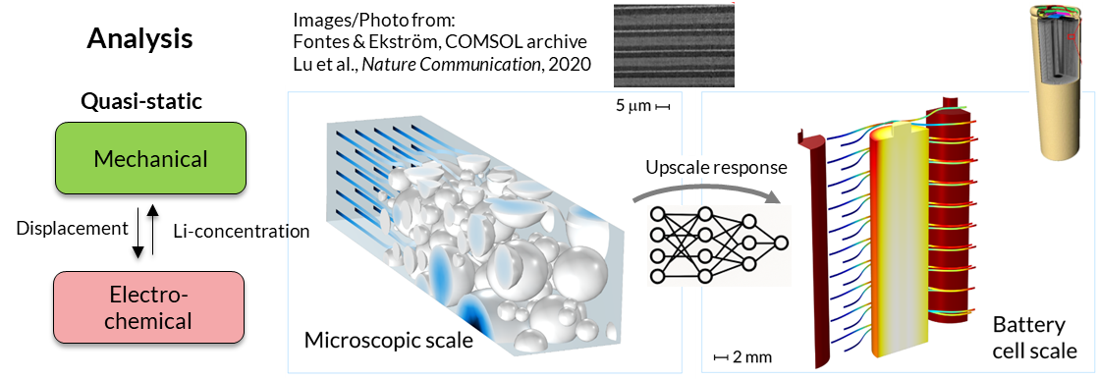
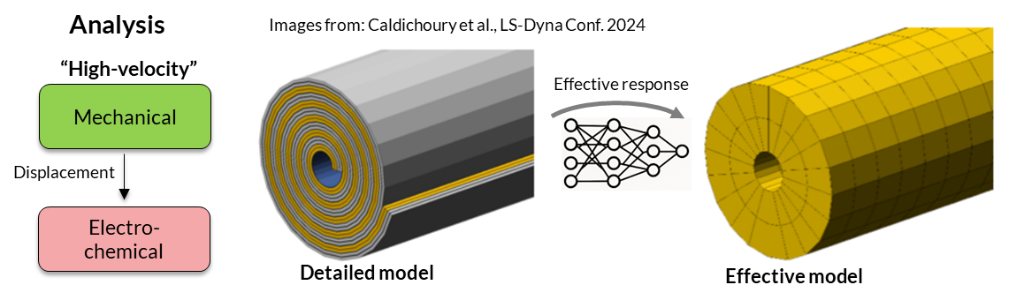
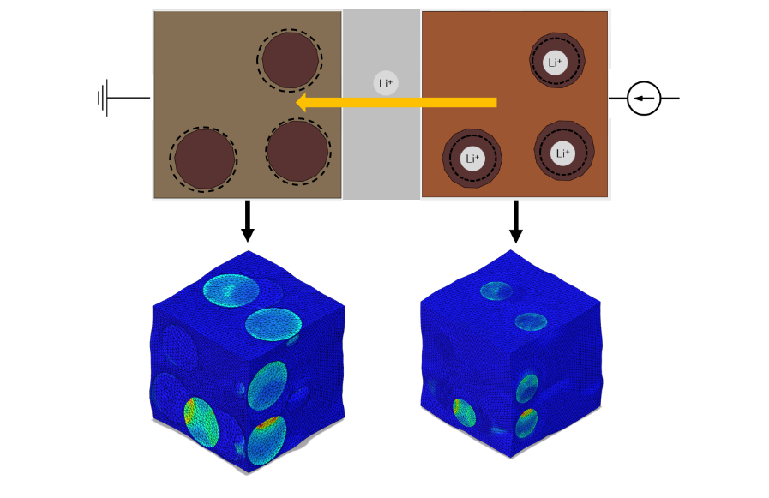
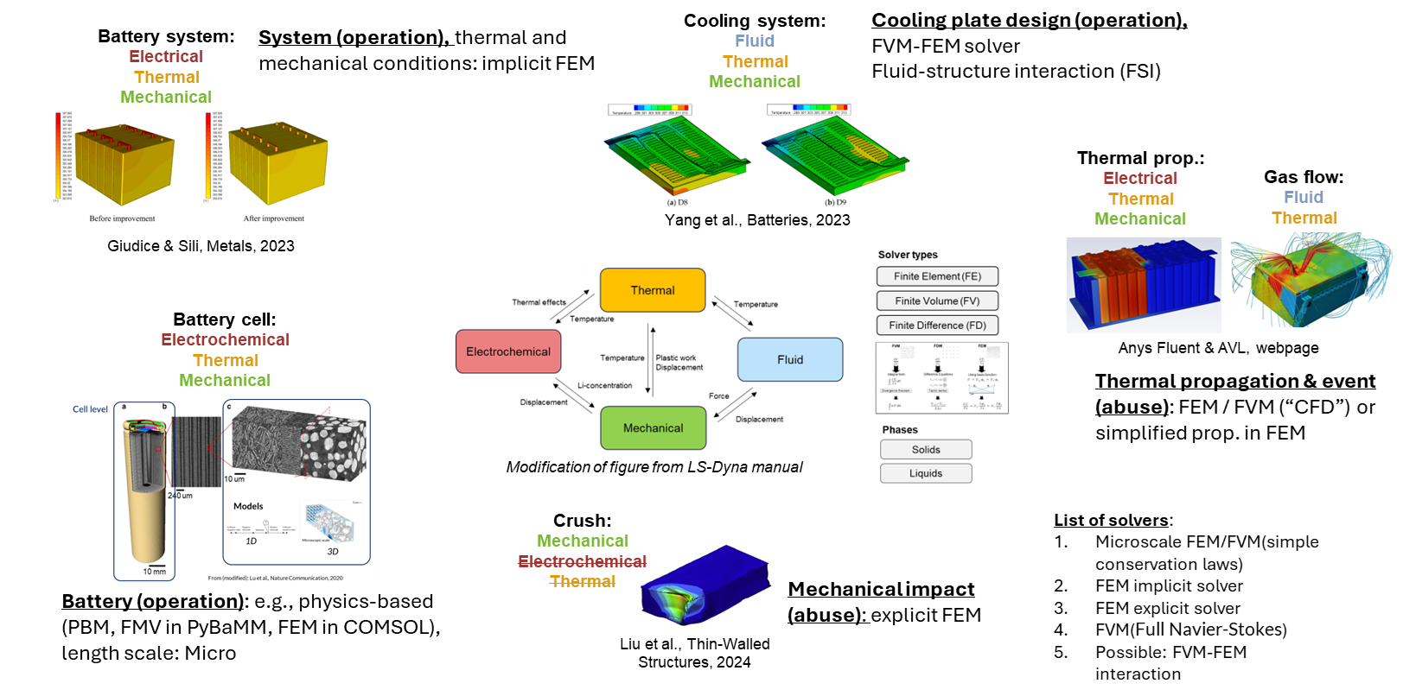
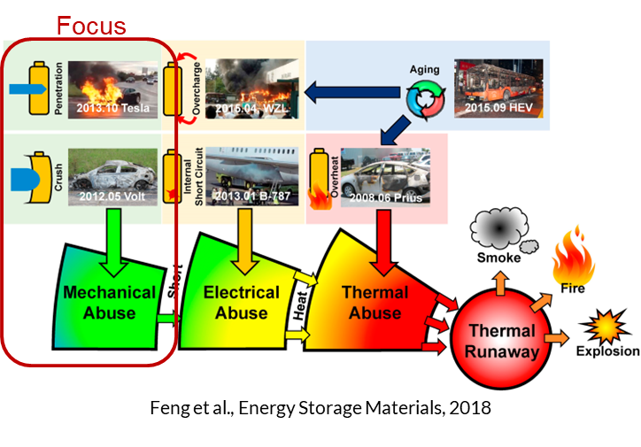
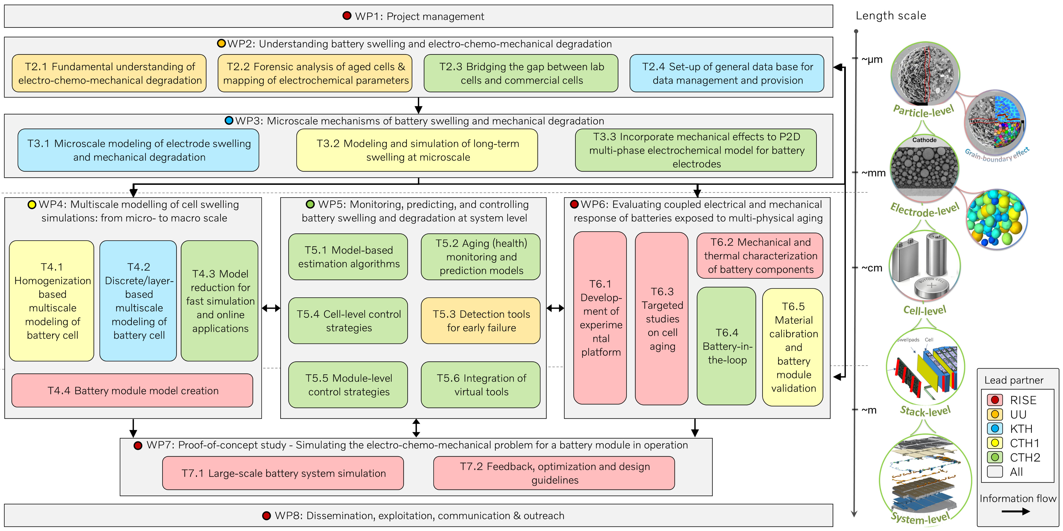
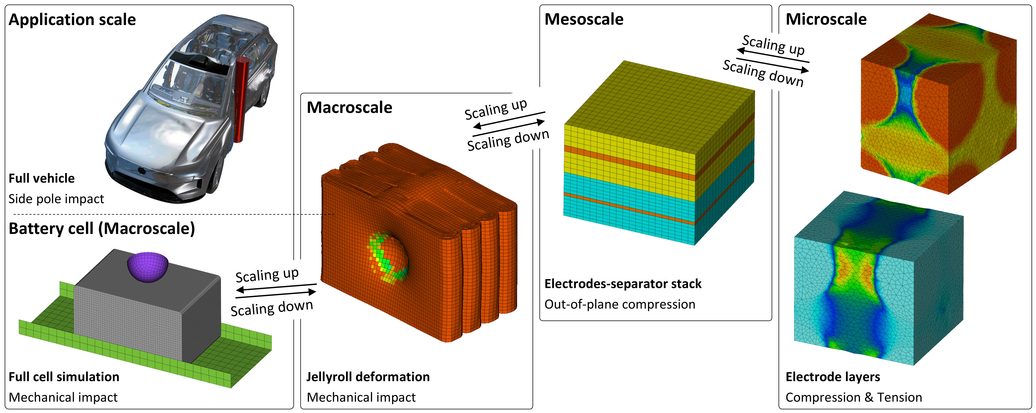
Two tracks & Related activities
Two tracks
Focus
Simulation model: Multiphysics battery model for lifetime prediction
Simulation model: Impact model for short circuit prediction
OPTIMUS application
Carlstedt et al., Journal of Power Sources, 2025
Matty et al., Manuscript
Multiphysics model development: Internal RISE initiatives, STRIVE & SDV application

Slide 5


Step 1: Battery modelling
2. Upscale response
Features
Targets
3. Cell level response
1. Battery model microscale
Physical constraints

Slide 6
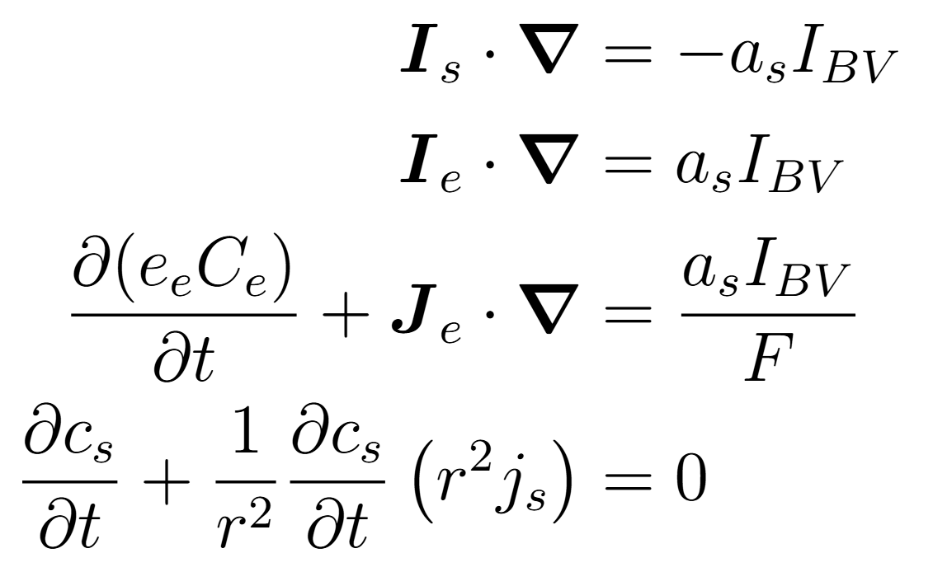
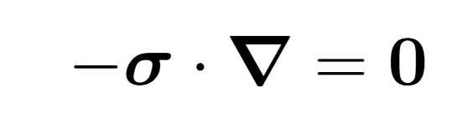
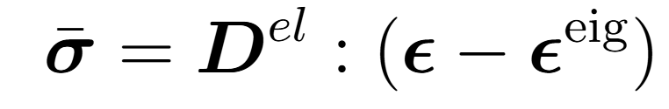

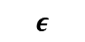
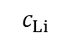
DFN or P2D model: Balance equations Example
Porous electrode theory & assumption of electroneutrality, cf. Newman and Tiedemann, AICHE J, 1975 and Doyle et al., Journal of Electrochemical Society, 1993
(E)lectrical, (C)hemical, (M)echanical
Electrochemical
Mechanical
$$c_{Li}$$
$$ε$$
Mass and charge balance (Battery function)
(E)
(E)
(C)
(C)
Momentum balance (Structural function)
(M)
Contribution: e.g., particle swelling/shrinkage
Kulathu et al, Int J Numer Methods Eng, 2024

Slide 7
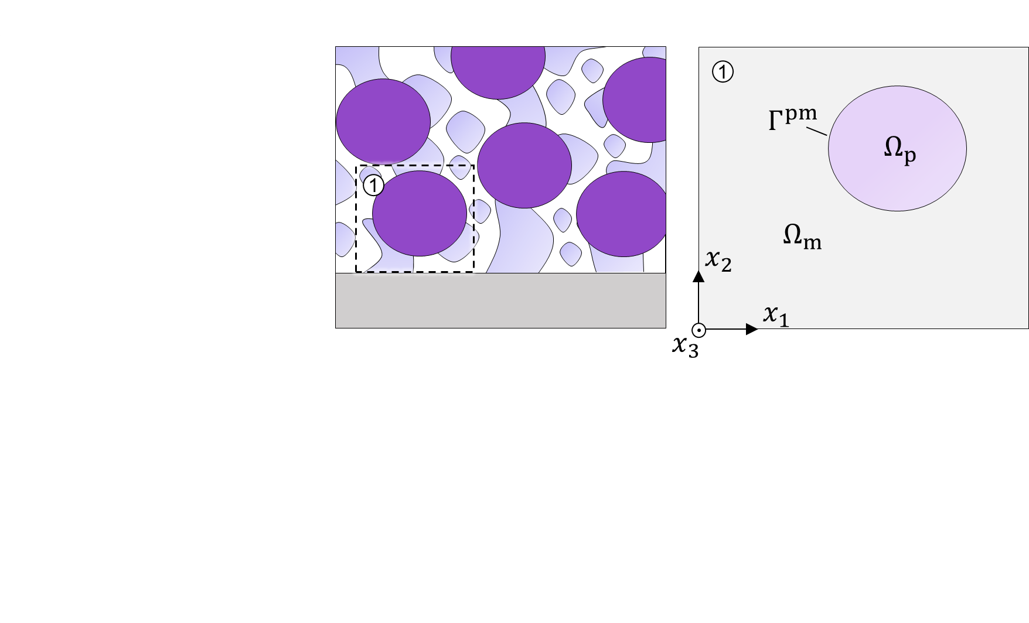
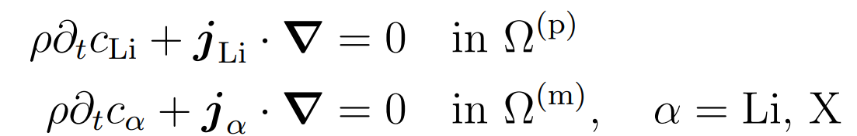
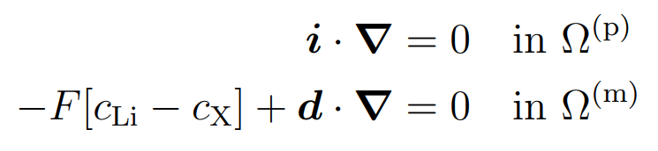
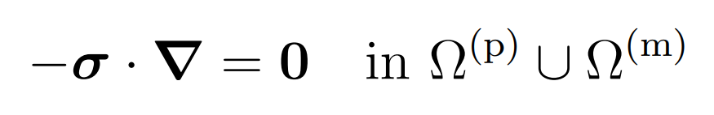
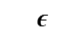
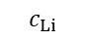
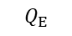
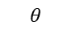
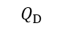
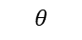
Balance equations: Electrochemical-thermal-mechanical
Mass and charge balance
$$Q_{E}$$
Thermal energy balance
$$θ$$
Linearized
(quasi-static)
Momentum balance
$$c_{Li}$$
$$θ$$
$$ε$$
No body force
$$Q_{D}$$

Slide 8

Battery models
Software:
PyBaMM (Python Battery Mathematical Modeling): open-source Python library designed for simulating batteries
COMSOL Multiphysics

Slide 9
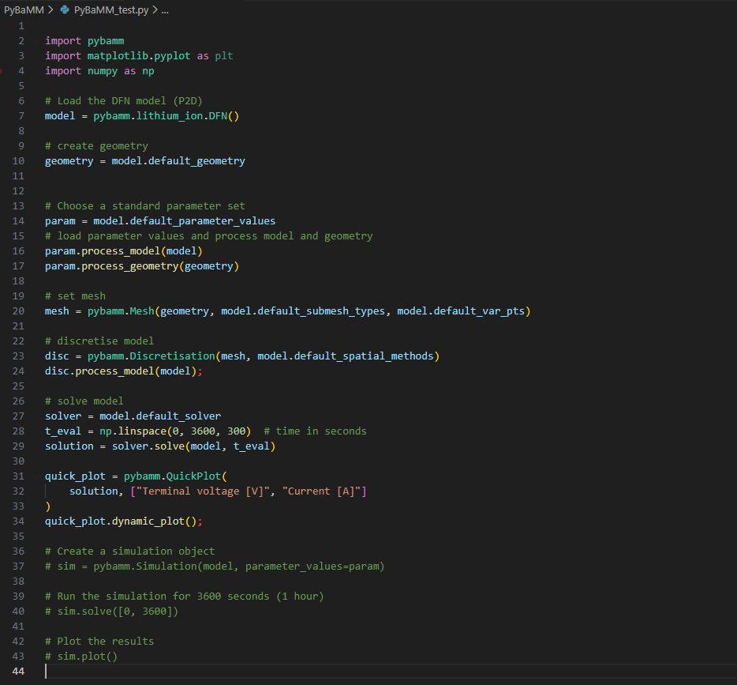
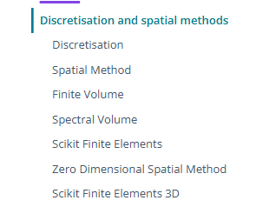
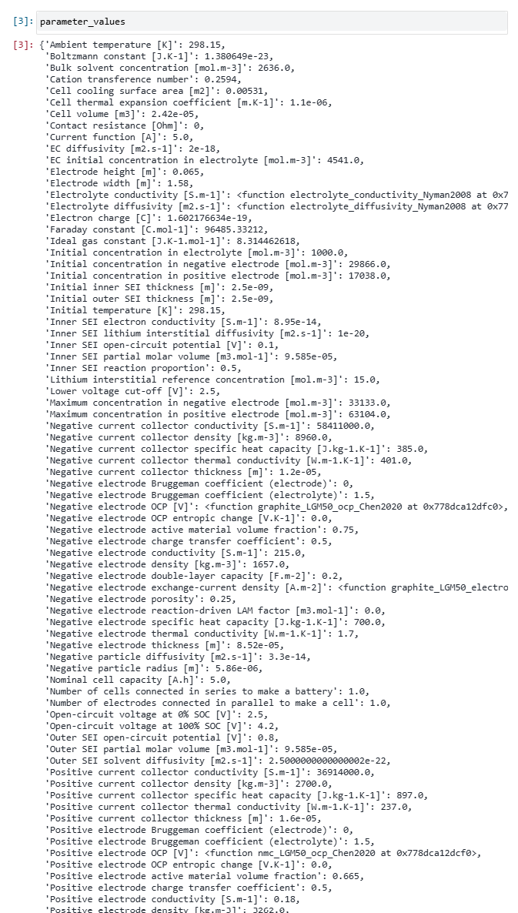
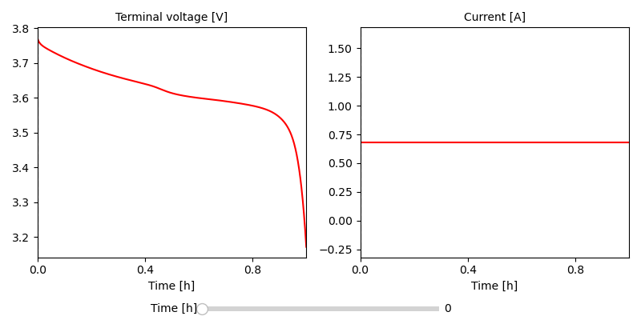
Battery model
This model is called DFN (Doyler-Fuller-Newman)
PyBaMM - Homepage
Battery model microscale → Cell level response
Discretizes PDEs: Default spatial discretization → Finite volume (simple mass conservation)
Pybamm package need
Select model: here DFN used
Using default geometry, parameters, mesh (note: these can easily be changed)
Solve (using default settings) & Plot results
List of parameters
File: PyBaMM_test.py

Slide 10
Step 2: NN-model (with simple PC)
2. Upscale response
Features
Targets
3. Cell level response
1. Battery model microscale
Physical constraints

Slide 11
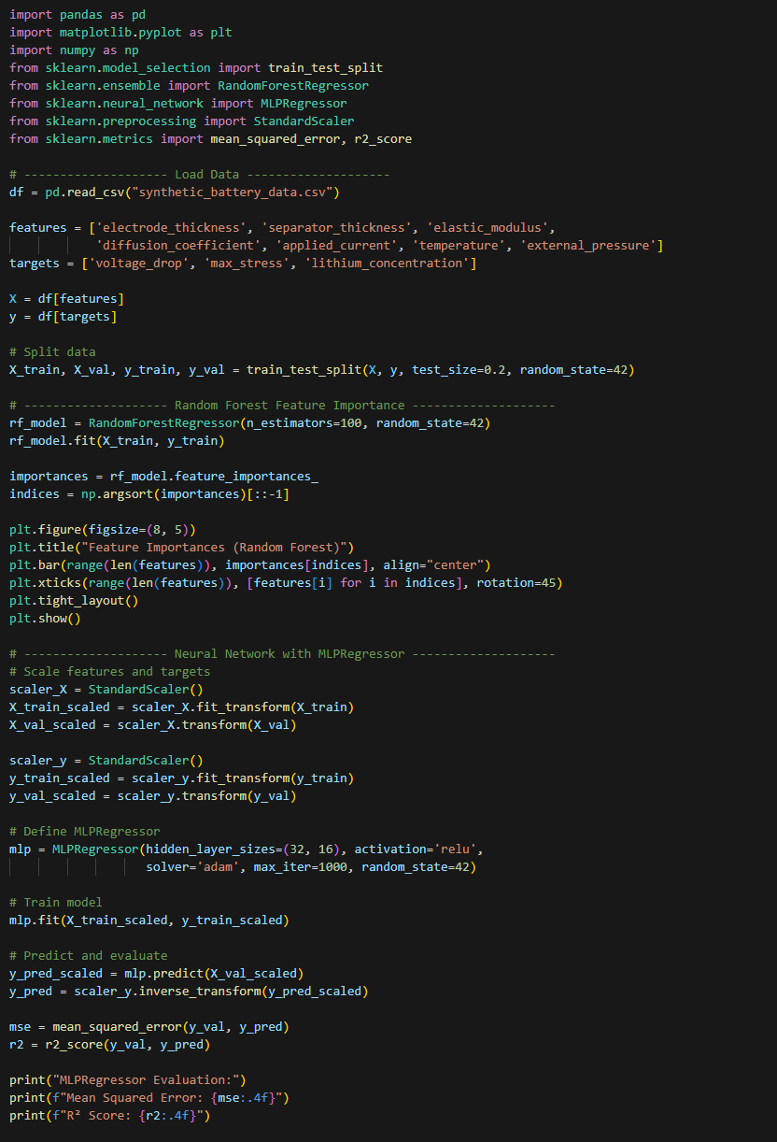
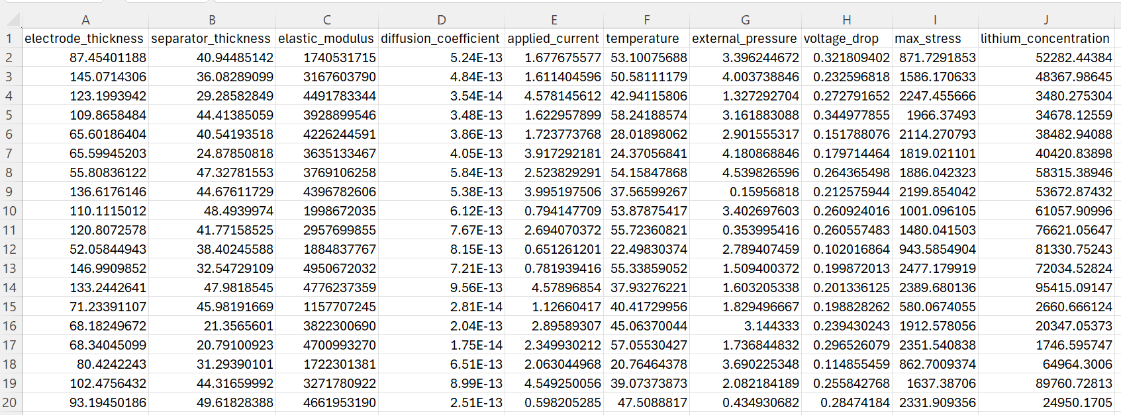
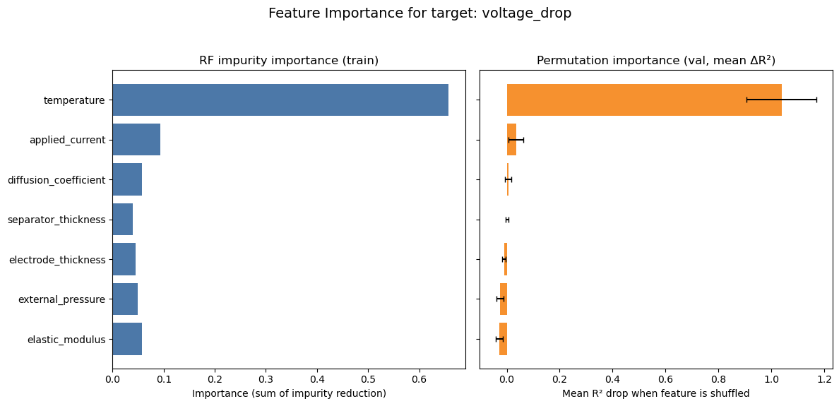
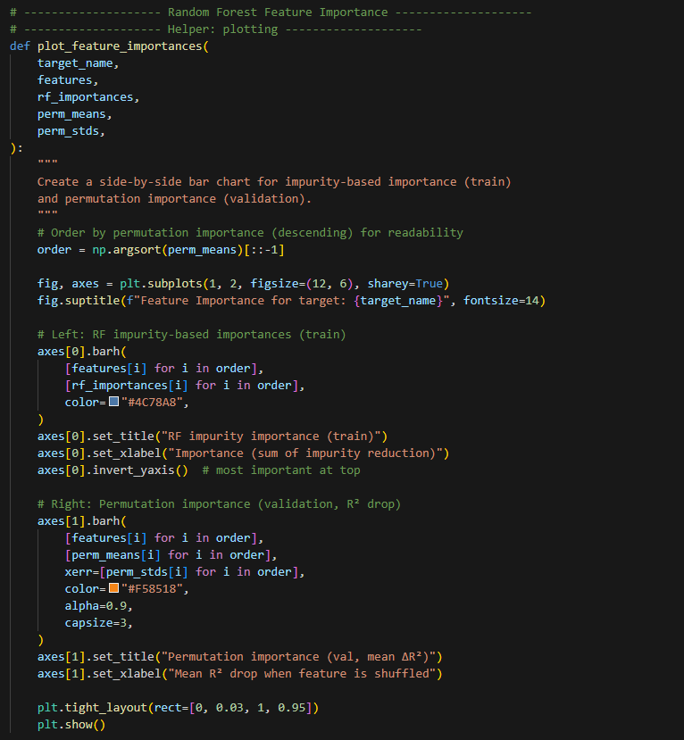
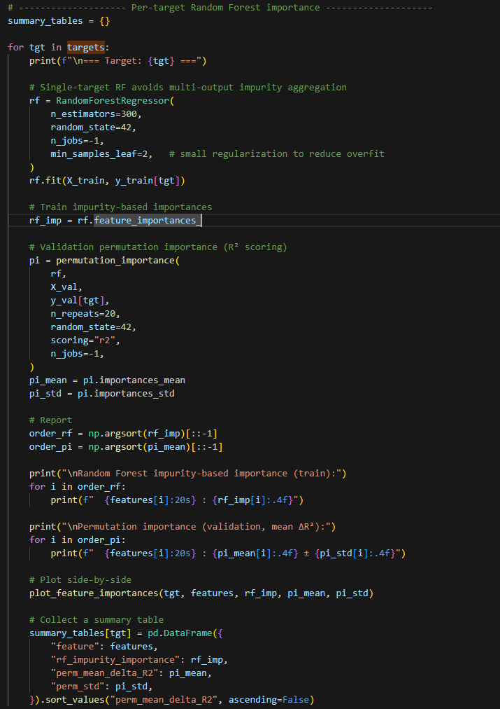
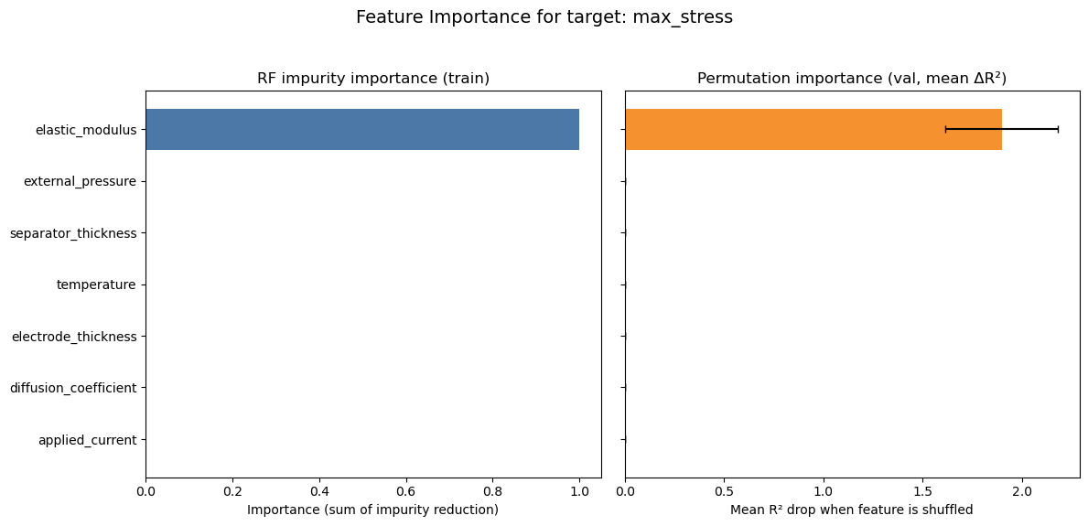

Neural network – Test case 1
Summary: Artificial data generated → linking Features & Targets
Feature: electrode and separator thickness, elastic modulus, etc.
Targets: Voltage drop, max stress, Li-concentration
Toolbox: Sklearn, MLPRegressor
Split, simple standard: 20% of the data goes to validation, and 80% goes to training
Start the random “shuffle”, here from 42 (“the answer to life, universe & everything”)
1.
Random Forest for feature importance
Step 1: Plot function,
Step 2: Run RF
Features (Input)
Targets (Output)
Read data
2.
Training
Validation
Artificial data (file: synthetic_battery_data.csv)
Sanity check e.g., stress only affected by E-modulus
File: ML-test_example.ipynb
Notes:
RF impurity importance = internal measure from training splits
Permutation importance = actual performance drop on unseen data when a feature is disrupted

Slide 12
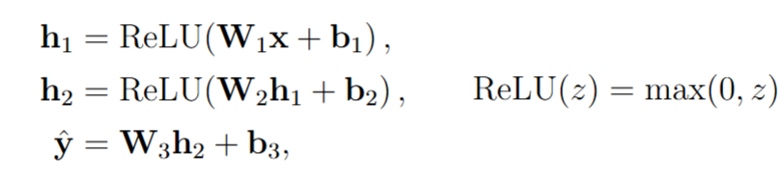
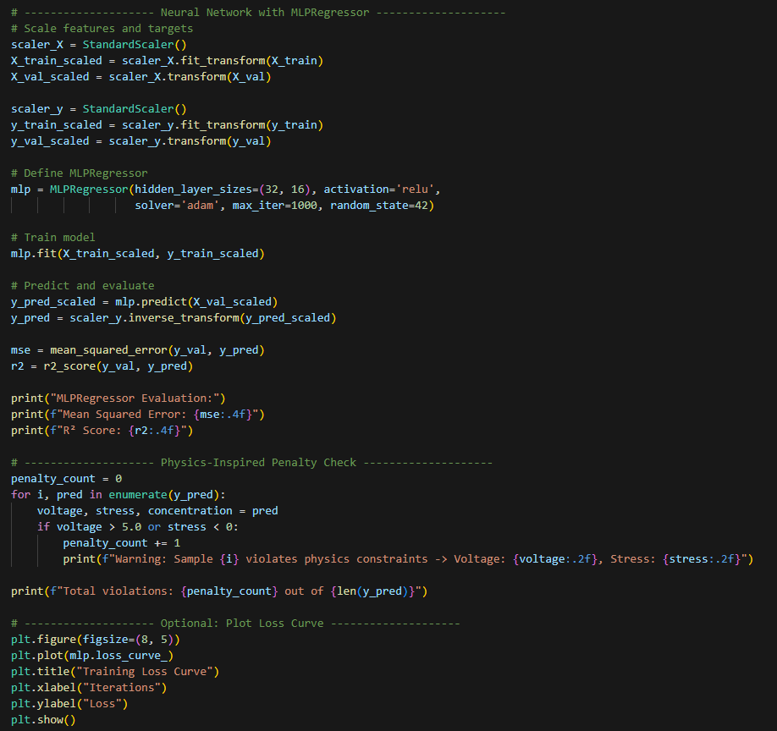
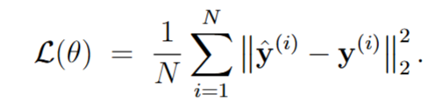
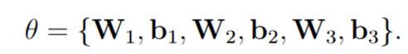
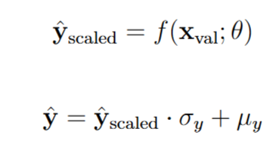
Neural network – Test case 1, Cont’d
Summary: Artificial data generated → linking Features & Targets
Feature: electrode and separator thickness, elastic modulus, etc.
Targets: Voltage drop, max stress, Li-concentration
Toolbox: Sklearn, MLPRegressor
MLPRegressor (feedforward neural network), with activation='relu’
Layers: 2 hidden layers with sizes 32 and 16
Train model:
solver='adam': robust, adaptive steps (good default for many problems)
max_iter=1000: gives enough iterations for convergence (often combined with early stopping if enabled).
Scale training and validation data → Train faster and “better” when inputs and outputs are similar
3.
3 (y)
7 (x)
32 (h1)
16 (h2)
Predict scaled space & convert back to original units
File: ML-test_example.ipynb
Notes:
The MLPRegressor in scikit-learn is a (feedforward) neural network-based regressor that uses a Multi-Layer Perceptron (MLP) architecture for predicting continuous values.

Slide 13
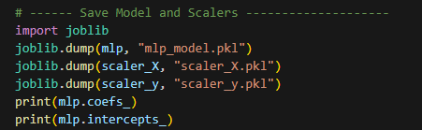
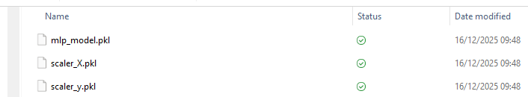
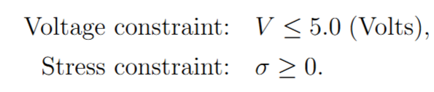
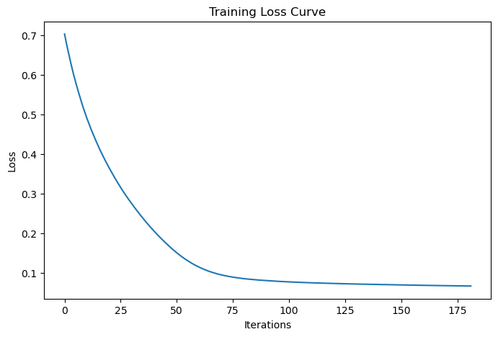
Neural network – Test case 1, Cont’d
Summary: Artificial data generated → linking Features & Targets
Feature: electrode and separator thickness, elastic modulus, etc.
Targets: Voltage drop, max stress, Li-concentration
Toolbox: Sklearn, MLPRegressor
Save and export model:
Model object after training (weights, biases, architecture)
Scalers: scaler_X and scaler_y (needed for consistent input/output scaling)
4.
3.
Very simple form of “Physics-inspired” penalty check
Plot loss curve from training
File: ML-test_example.ipynb

Slide 14
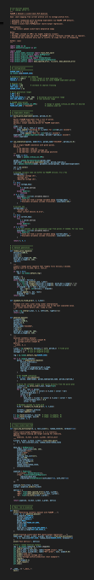
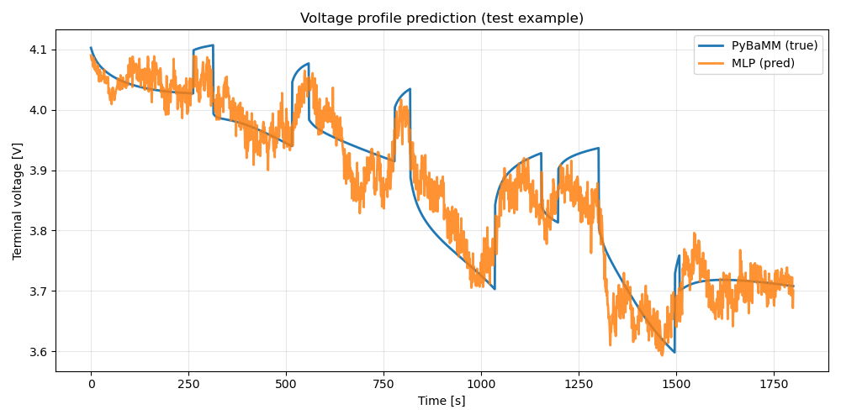
Neural network – Test case 2
Summary: PyBaMM → Dataset → Scikit-learn MLP baseline
Goal: Learn mapping from current profile I(t) to voltage profile V(t).
Simulation in PyBaMM: randomized pulse discharge experiments
Feature: Current; Targets: Voltage
Toolbox: Sklearn, MLPRegressor
Initialization
Create charge-pulse experiment
Generate data using PyBaMM simulations
Train → MLPRegressor
Run & plot
Test metrics: {'MSE': 0.0023, 'MAE': 0.037, 'R2': 0.80}
File: Scikit_Learn_PyBaMM_test.py

Slide 15
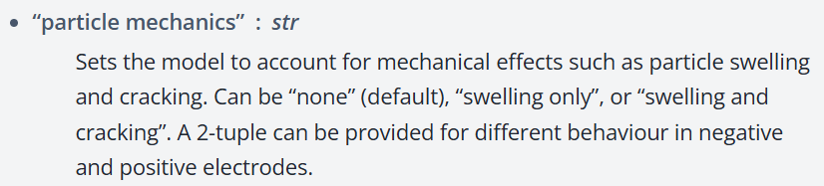
Next steps
Evaluate options for finite elements and swelling in PyBaMM (set up meeting with Gregory at Imperial)
Target vs. Features: Initial model vs. final model(s)
AI/ML-framework: structure, steps, control variables, etc.
Evaluate COMSOL models
Plan for meetings with VCC & BMW
Files available in OneDrive folder: https://risecloud-my.sharepoint.com/:f:/g/personal/david_carlstedt_ri_se/IgDRk3TrF_GXRr_m7z_v6MLUAXtESGPAxC6sUhvwh6l2ADE?e=gGAnaf
Intro
ML + PyBaMM
Start
COMSOL?
End
Jan
Feb
Mar
Apr
May
Jun
Jul
(David parental leave?)

Slide 16
Literature
Matty 2025 MSc thesis Chalmers - Modelling of Electrode Swelling in Lithium ion Batteries - Thesis work from 2025 at VCC. This thesis: explore if/how AI/ML-methods can be used for upscaling the response.
Asheri 2023 - Data-driven multiscale simulation of solid-state batteries via machine learning - Train a surrogate model (based on NN) on a large set of simulation data, which is afterwards employed to predict the cell performance
Meyer and Ekre 2023 – Thermodynamically consistent neural network plasticity modelling and discovery of evolution laws - Thermodynamically consistent NN for plasticity modelling and discovery of evolution laws.
Panahi et al 2025 - Fast and generalisable parameter-embedded neural operators for lithium-ion battery simulation.pdf - Machine learning surrogates for battery modelling.
Guo 2025 - Uncovering the impact of battery design parameters on health and lifetime using short charging segments.pdf - ML framework for corresponding problem (using digital twin to generate data).
Schmid 2024 - Sequential Multi-Scale Modeling Using an Artificial Neural Network-Based Surrogate Material Model for Predicting the Mechanical Behavior of a Li-Ion Pouch Cell Under Abuse Conditions.pdf - Similar approach, but for the pure mechanical response of batteries under mechanical impact loading
Available in OneDrive folder: https://risecloud-my.sharepoint.com/:f:/g/personal/david_carlstedt_ri_se/IgDe4VhtG6K6QYEwl2IvgTF_AQGRaxLuo-oZgD-0o_sqzro?e=VeB9ep

Slide 17








Related work
State-of-the-art ML-battery-models do not account for mechanical or thermal aspects!
Paper from Uppsala Uni.
Work from Automation Control, Chalmers (Changfu & Torsten)
Work from SINTEF:
Electrolyte conductivity ( “battery literature” def.):
1. Gou et al. Uncovering the impact of battery design parameters on health and
lifetime using short charging segments, 2025, https://doi.org/10.1039/D5EE03268G
Mechanical based signals
2. Xiaolei Bian, Chalmers (supervisors Changfu & Torsten), https://doi.org/10.1016/j.ensm.2025.104410
Traditional to PINN
Smoother relation +
Avoid negative (non-physical)
3. Eibar Flores, SINTEF

Slide 18

Thesis background
Title: Physics-enforced machine learning surrogate modelling of electrochemical-mechanical battery simulations
Background:
Wanted → Efficient, reliable models for early evaluation of battery designs and to support predictive maintenance and control
High-fidelity battery models computationally expensive, limiting design-stage & real-time usability
Physics-enforced ML → a path to fast, interpretable, and physically consistent surrogate models?
Knutsson & Trombati, MSc Thesis, 2021

Slide 19
Battery length scales
Cell level
Microscale
Models
1D
3D
From (modified): Lu et al., Nature Communication, 2020

Slide 20

Thesis background
Thesis objectives:
Generate simulation data from a detailed electro-chemo-mechanical model (including swelling and material response)
(Set-up and) Train a physics-enforced ML model to replicate the full model’s behaviour under varying conditions
Extract analytical expressions using symbolic regression for simplified use in design/control
Explore generalization across design variations (geometry, materials, loading)
Investigate Geometric Deep Learning for efficient sampling/training data generation

